Slide 1
PRESENTED BY :-
VINIT K
3VC19CS414
INTERNSHIP
ON
internet of things

Slide 2

COMPANY OVERVIEW
Pantech e Learning Pvt . Ltd is a leading IT software solutions and services industry focusing on quality standards and customer values.
They offer broad range of customized software applications powered by concrete technology and industry expertise.
They offer scalable end-to-end application development and management solutions from requirement analysis to deployment and rollout.

Slide 3
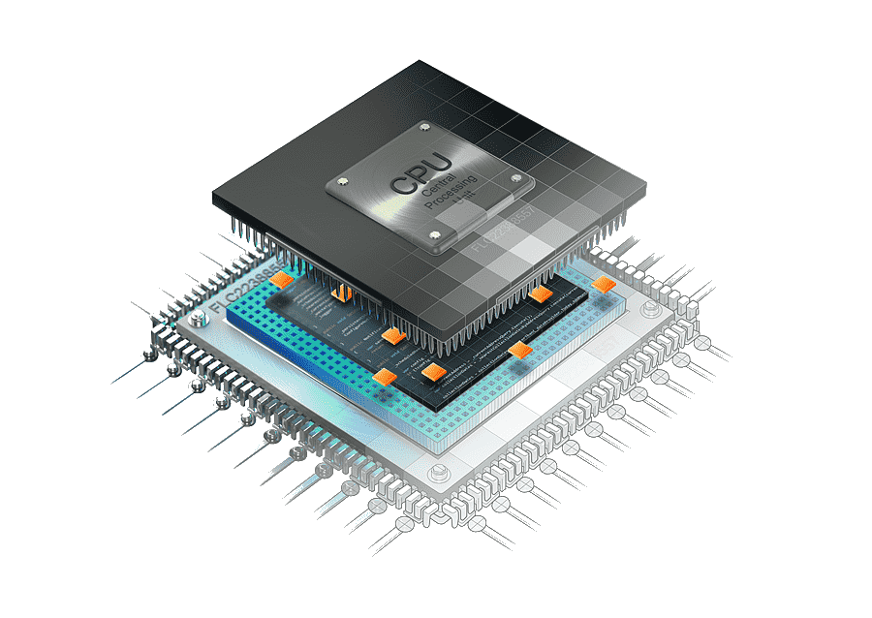

SERVICES OFFERED BY THE COMPANY
IT solutions and services
Embedded design and development
Academic projects
Implant Training
Software courses

Slide 4
INTRODUCTION TO IOT
Interface powerful devices capable of connecting to the internet wirelessly or wired, depending on the complexity of the application
Embedded System introduces to the amazing world of automation and its fascinating applications.
Using the Arduino / Raspberry pi to develop an electronic device that streams interfacing Digital sensors and Analog sensors data over the internet.
Custom-made applications to solve some simple real-world problems. By Interfacing sensors with controller, Interfacing controllers with multiple clouds, Controlling Peripherals Through Webpage

Slide 5
IOT BASED WEATHER STATION BY USING DHT 11 SENSOR
The monitoring of environmental variables such as temperature, pressure and humidity has a long history of development and the variables have shown significant impact in the productivity of plant growth.
The quality of food industry and the efficiency of many temperature and humidity-sensitive equipment
The monitoring of temperature and humidity of laboratories, storages, halls, school and hospitals is important with respect to health and hygiene.
In this IOT project to Monitor Humidity and Temperature by used Arduino Uno, DHT 11 Sensor and Esp8266 wifi Module
To view the current Humidity & Temperature data over the Internet using the ThingSpeak server.

Slide 6
WORKING MODULE
This IOT based project having four sections, firstly Humidity and Temperature Sensor DHT11 senses the Humidity and Temperature Data.
Secondly Arduino Uno extracts the DHT11 sensor’s data as suitable number in percentage and Celsius scale, and sends it to Wi-Fi Module.
Thirdly Wi-Fi Module ESP8266 sends the data to ThingSpeak’s Sever.
Finally ThingSpeak analyses the data and shows it in a Graph form. Optional LCD is also used to display the Temperature and Humidity.

Slide 7
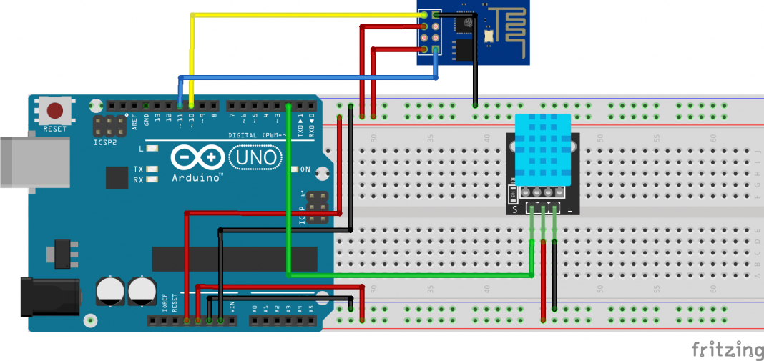
CIRCUIT DIAGRAM

Slide 8
COMPONETS REQUIRED
Hardware
Arduino
DHT 11 Sensor
ESP8266
LCD Display
Jumper Wires
Software
Arduino IDE
Thingspeak

Slide 9

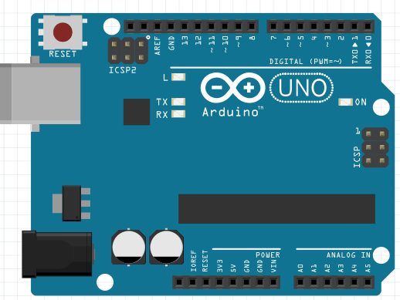
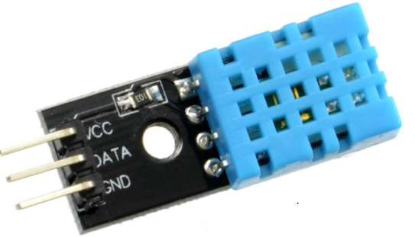
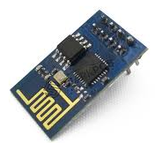
COMPONENTS
DHT 11
Arduino
ESP8266 WIFI

Slide 10

THINGSPEAK

Slide 11
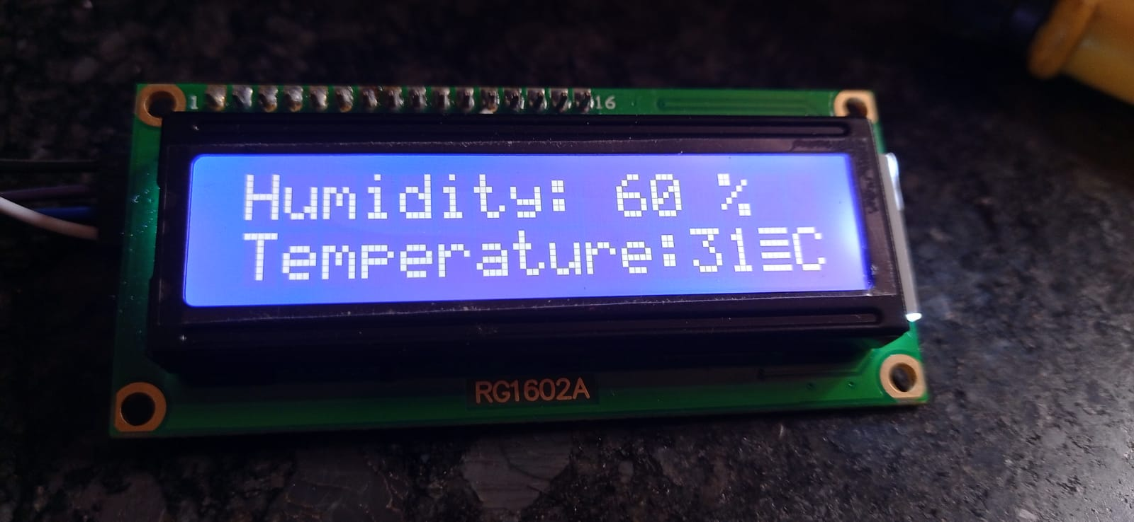
RESULT/SNAPSHOT

Slide 12
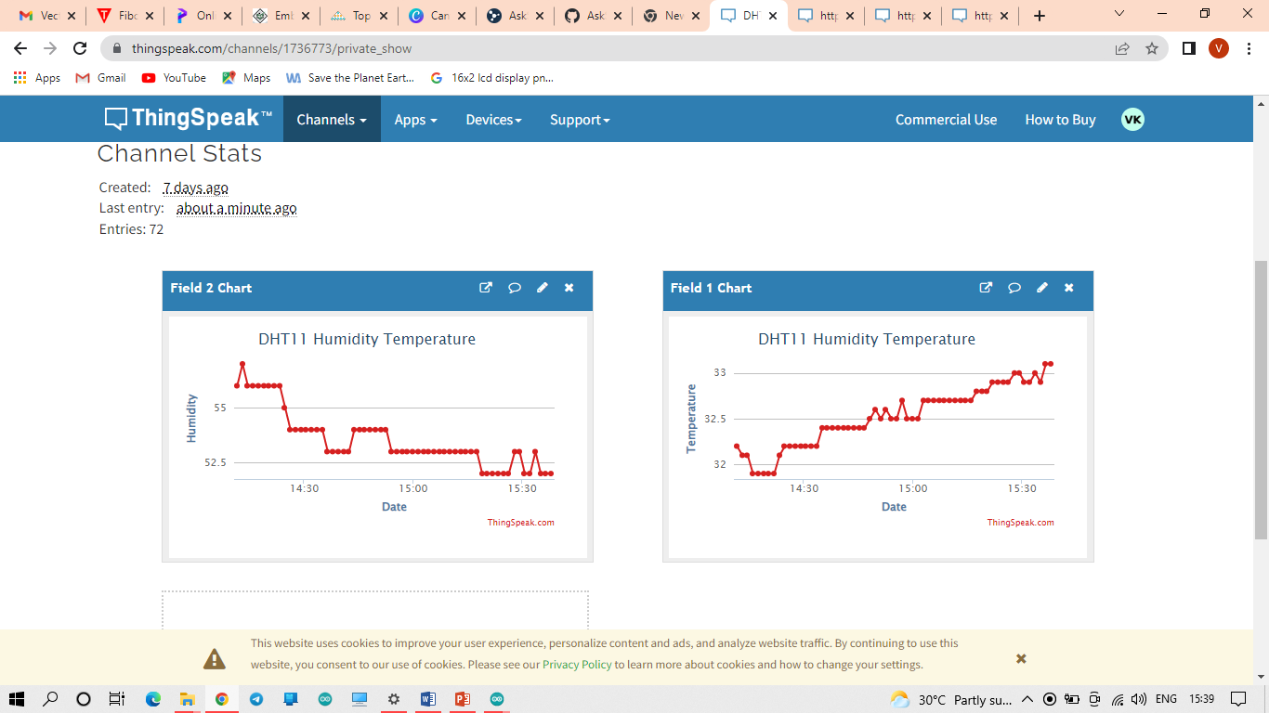
THINGSPEAK DATA

Slide 13
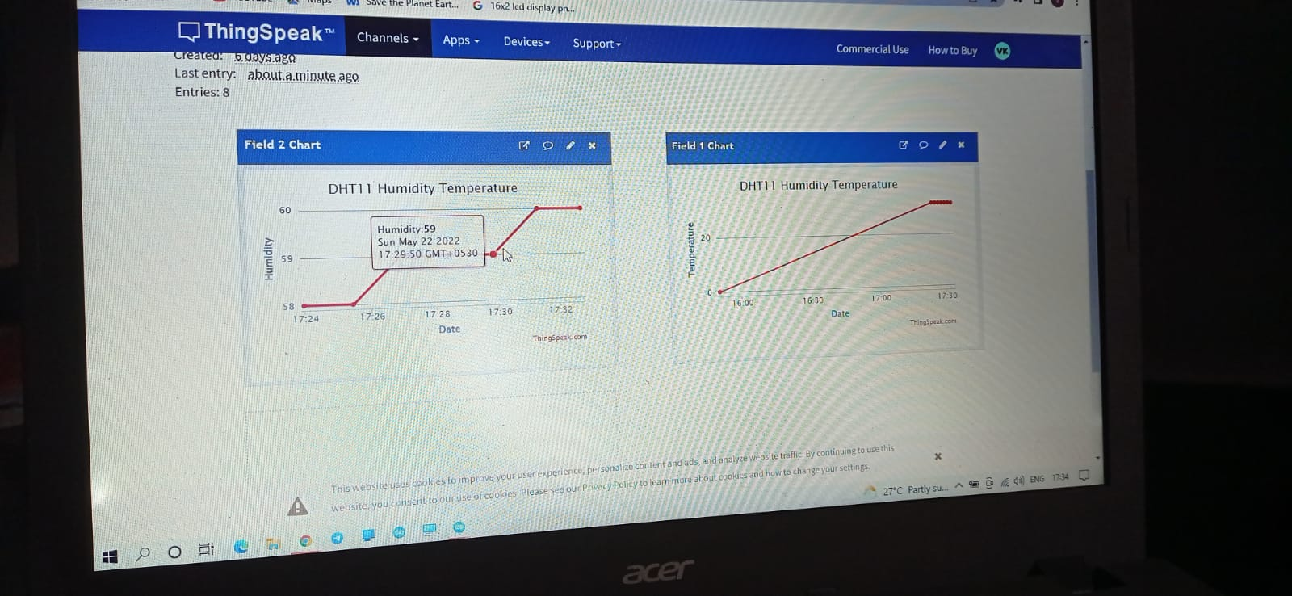
THINGSPEAK DATA

Slide 14
CONCLUSION
This weather station gives accurate data, in the future bring it to areas where weather readings aren’t accurate and give people the ability to have accurate weather reports, which could help improve their daily lives.
It also provides a cheaper way to record weather data which could prove to be a huge benefit for anyone that chooses to utilize Arduino weather stations.

Slide 15
Thanks

